Slide 1
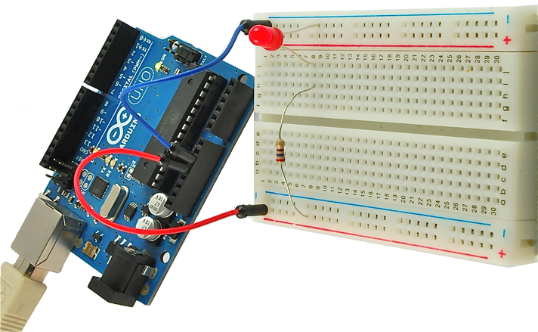
In The Blink Of An LED:
An introduction to physical computing

Slide 2
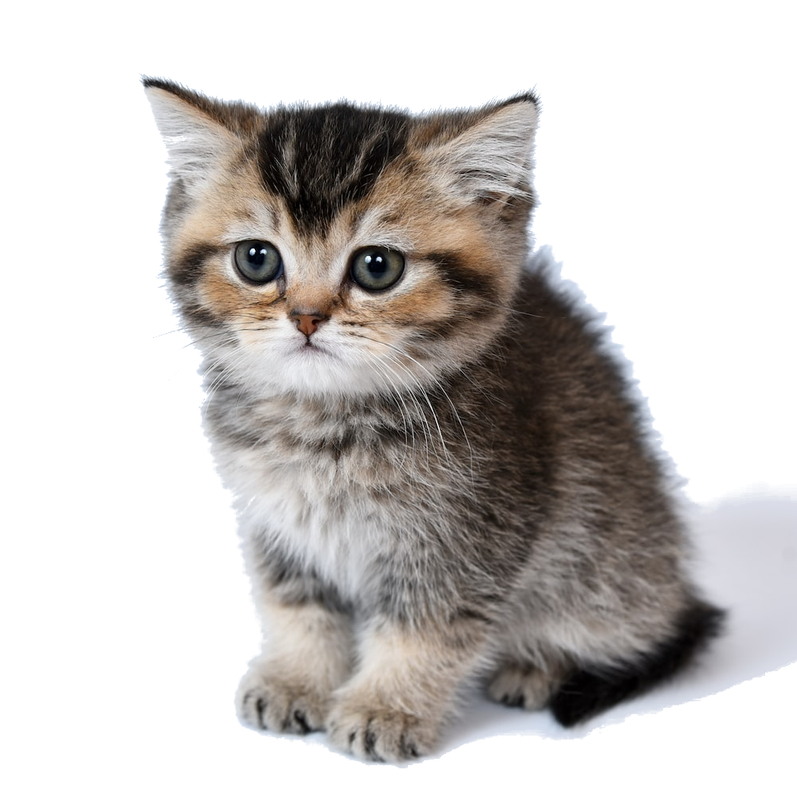
Overview of Class
Getting Started:
Context
Components
Software Installation
Electrical:
Ohm's Law
Circuits
Multimeters
Inputs and Outputs
Analog vs Digital
Microcontrollers:
Digital Outputs
Analog Outputs
Digital Inputs
Analog Inputs
Serial Communication

Slide 3


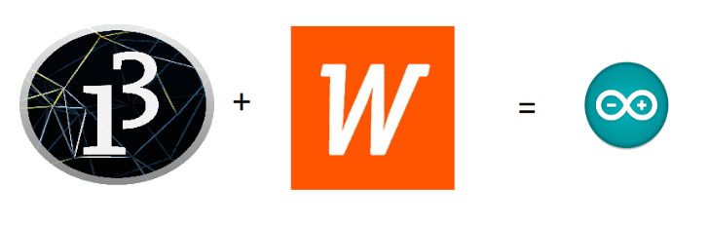
Wiring Library, Processing (and Arduino)
Open Source Hardware/Software
Processor
Coding is accessible & transferrable
(C++, Processing, java)

Slide 4

Quick Definitions
Arduino – can refer to the Amtel ATMEGA328p microcontroller, the development board or the programming environment
microcontroller – shitty computer, but generally one with GPIO and analog input pins
GPIO pins – general purpose input/output pins, send and receive signals from outside the chip
physical computing – using a computer to interact with the real world
development board – microcontroller with connectors to easily access the GPIO, analog input and power

Slide 5
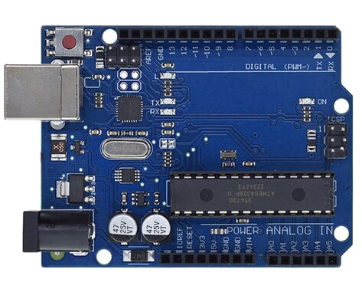
USB
(to Computer)
PWR IN
(7-12V)
RESET
SCL\SDA
(I2C Bus)
POWER
5V / 3.3V / GND
GPIO Pins
PWM(3, 5, 6, 9, 10, 11)
Analog INPUTS

Slide 6

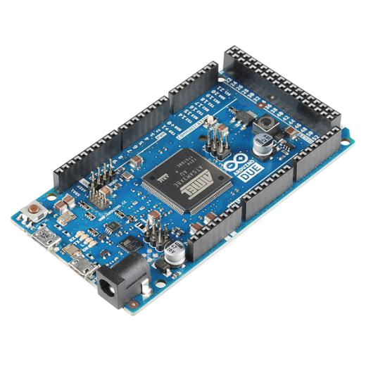
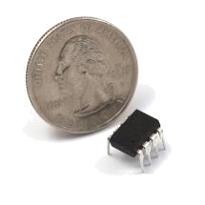
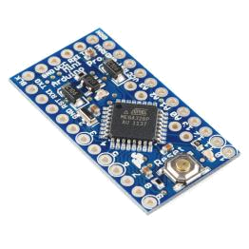
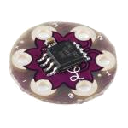
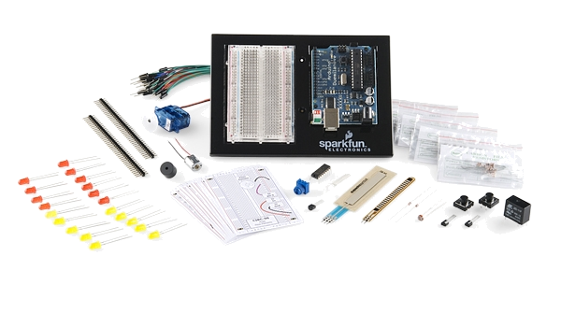
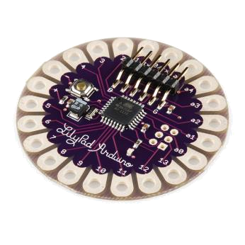
Arduino & Arduino Compatible Boards

Slide 7
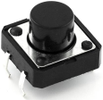
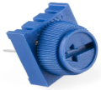
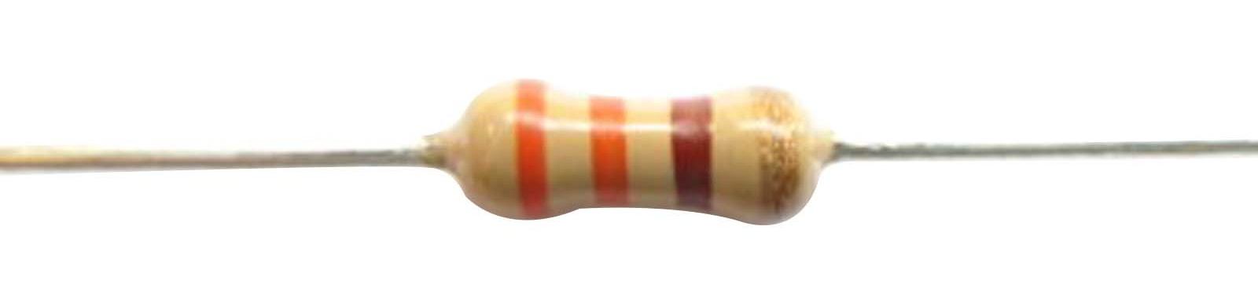
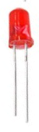
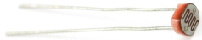

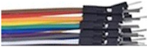
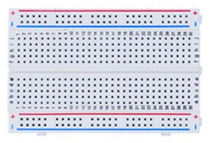
Included Components
Name | Image | Type | Function | Notes
Push Button |  | Digital Input | Switch - Closes or opens circuit
Trim potentiometer |  | Analog Input | Variable resistor | Also called a Trimpot.
Resistor |  | Passive Component | Drops Voltage | Color-Coded for Different Values
Photoresistor |  | Analog Input | Light Dependent Resistor (LDR) | Resistance varies with light.
LED |  | Digital & Analog Output | Emits a single wavelength light
RGB LED |  | Digital & Analog Output | 16,777,216 different colors | Ooh... So pretty.
Jumper Wires |  | Interconnect | Connects other components | Your extroverted friend
Breadboard |  | Interconnect | Where the connections happen | The neighborhood pub

Slide 8

Getting Started
https://microcontrollers.smartypantsconsulting.ltd
Sample Code
Schematic/Wiring Diagrams
Web Resources

Slide 9
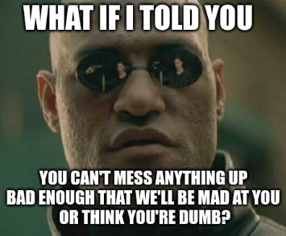

Getting Started
Notes:
This is why there’s a diversity problem in Engineering

Slide 10
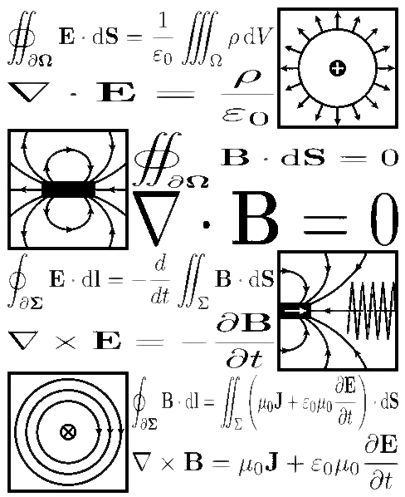
Electricity / Electronics Basic Concepts
Voltage
Current
Resistance
Ohm’s Law
Using a Multimeter

Slide 11
Electrical Properties
Voltage
V
Current
I
Resistance
R
The amount of potential energy in a circuit (how “hard” it can push electrons)
Units: Volts (V)
Related to number of electrons that flow through a circuit every second
Units: Amperes (A)
How difficult it is for electrons to flow through a circuit
Units: Ohms (Ω)

Slide 12
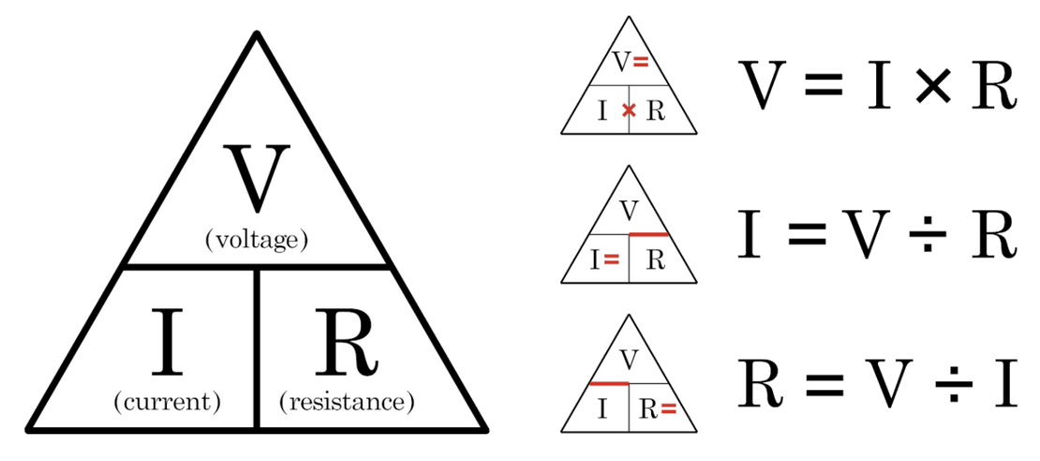
Ohm’s Law

Slide 13



Current Flow Analogy
High Current
Low Current

Slide 14

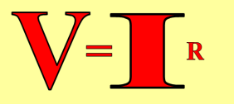

Voltage Analogy
Water
Tower
Water
Tower
V
V
More Energy == Higher Voltage
Less Energy == Lower Voltage

Slide 15
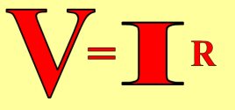
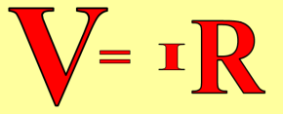
Resistance Analogy
Water
Tower
Water
Tower
V
Big Pipe == Lower Resistance
Small Pipe == Higher Resistance

Slide 16
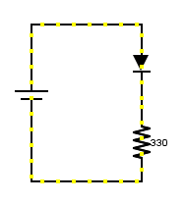
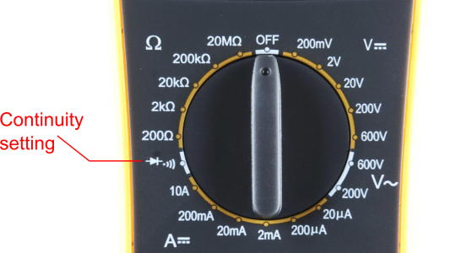
Continuity – Is it a Circuit?
The word “circuit” is derived from the circle. An Electrical Circuit must have a continuous LOOP from Power (V_{cc}) to Ground (GND).
Continuity- it is important to make sure all the portions of circuits are connected. Continuity is the simplest and possibly the most important setting on your multimeter. Sometimes we call this “ringing out” a circuit.

Slide 17
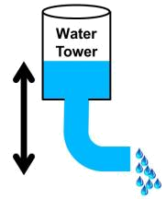
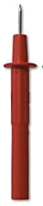
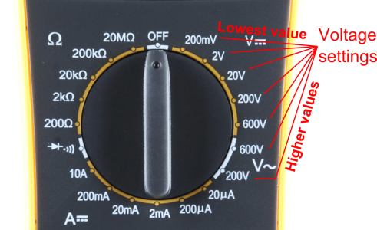
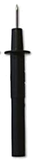
Measuring Electricity – Voltage
Voltage is a measure of potential electrical energy. A voltage is also called a potential difference – it is measured between two points in a circuit – across a device.

Slide 18
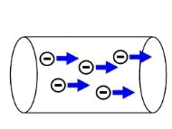
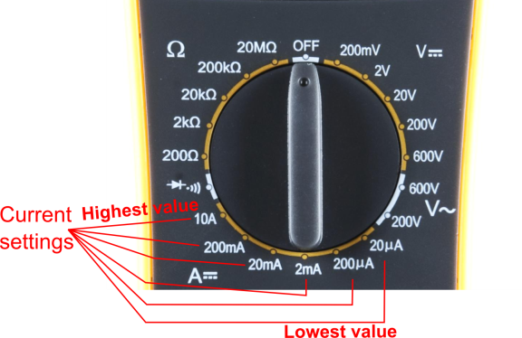
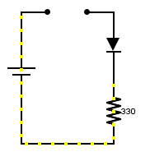
Measuring Electricity -- Current
Current is the measure of the rate of charge flow. For Electrical Engineers – we consider this to be the movement of electrons.
In order to measure this – you must break the circuit or insert the meter in-line (series).

Slide 19
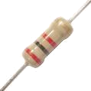
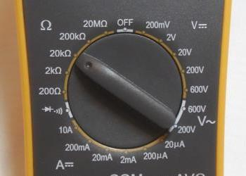
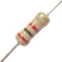
Measuring Electricity -- Resistance
Resistance is the measure of how much opposition to current flow is in a circuit.
Components should be removed entirely from the circuit to measure resistance. Note the settings on the multimeter. Make sure that you are set for the appropriate range.
Resistance
settings

Slide 20
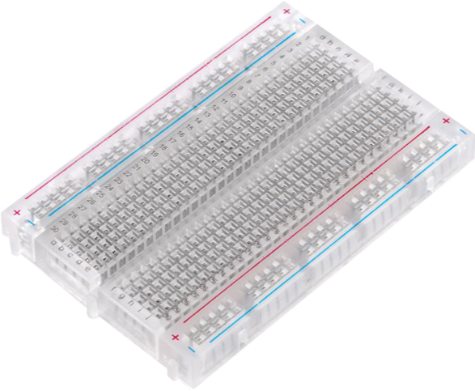
Prototyping Circuits Solderless Breadboard
One of the most useful tools in an engineer or Maker’s toolkit. Good things to remember:
A breadboard is easier than soldering
A breadboard isn’t the same as soldering
Sometimes breadboards break
Sometimes breadboards don’t make good connections
They’re not good for high-speed applications
Know what dots are connected to each other

Slide 21
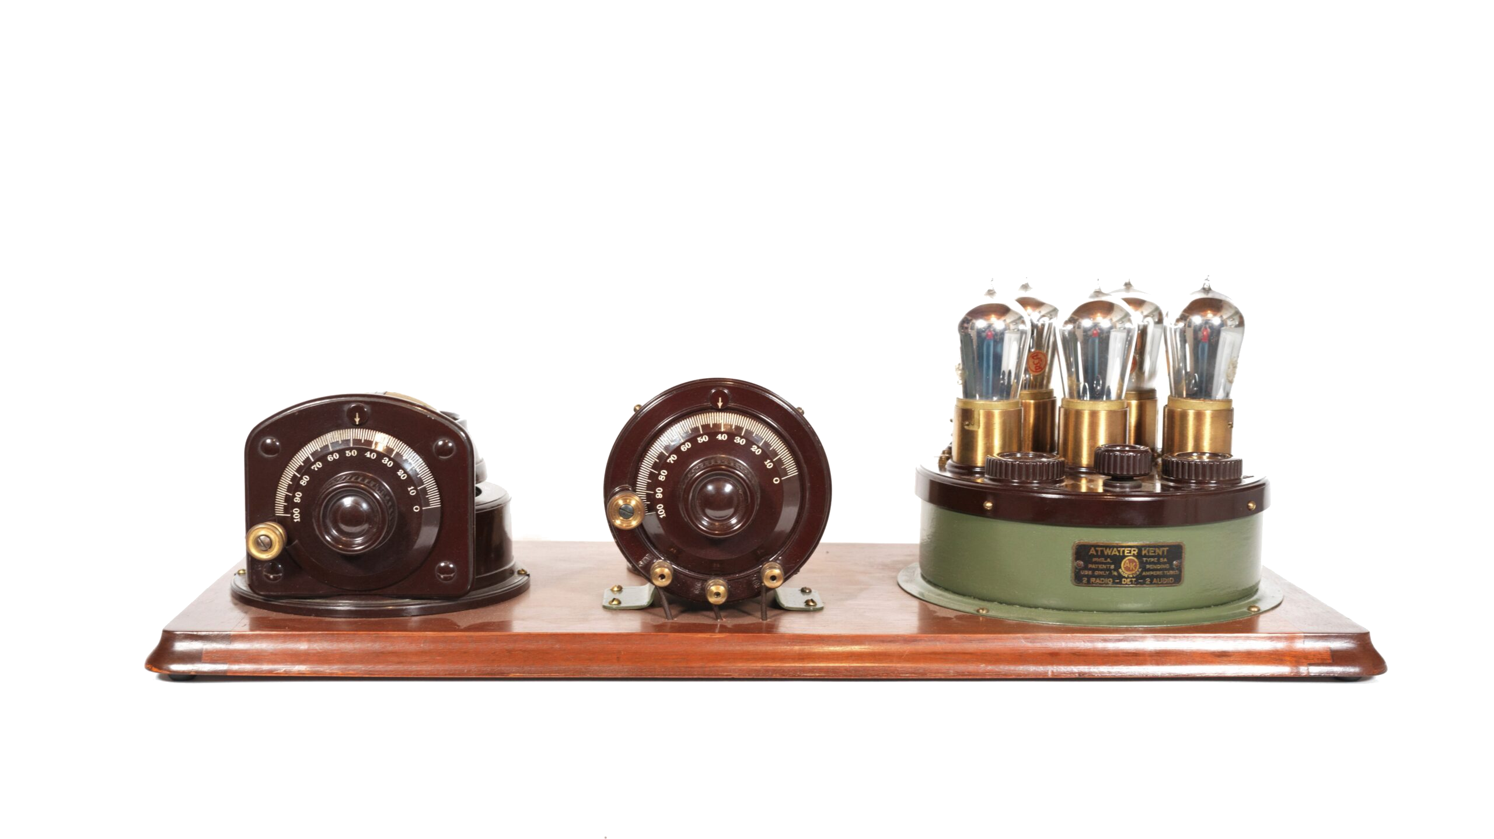
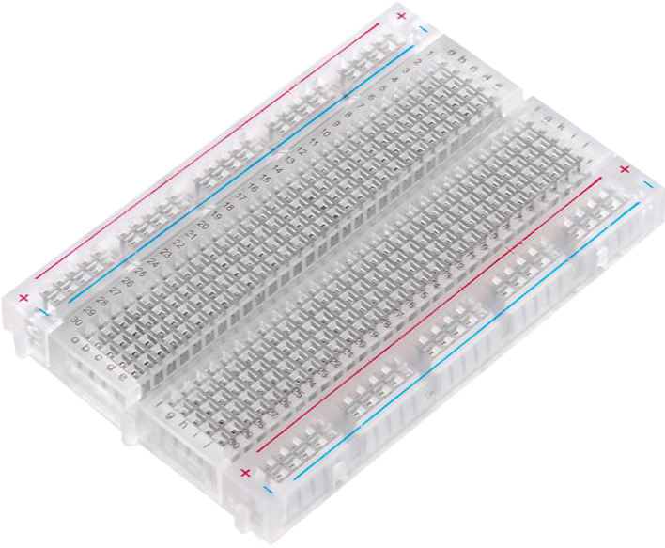
Why a Breadboard?
Atwater Kent Radios (ca 1923)

Slide 22
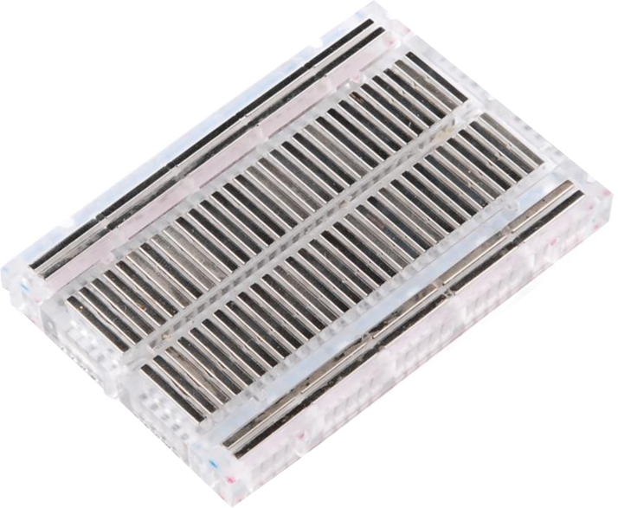
What’s a Breadboard?

Slide 23
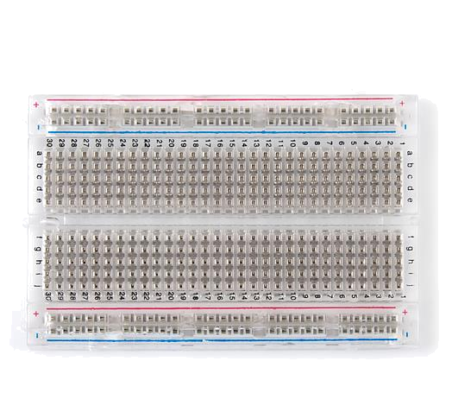

How It’s All Connected
Each row (horizontal) of 5 holes are connected
Vertical columns- called power buses- are connected vertically

Slide 24
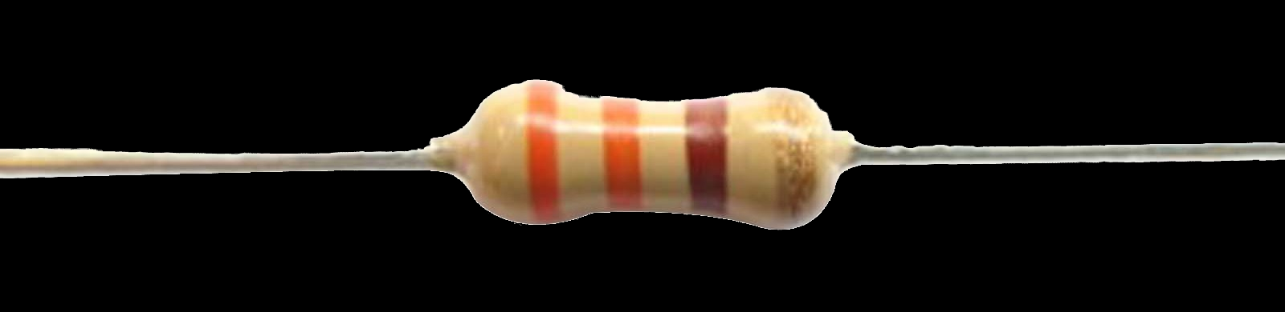
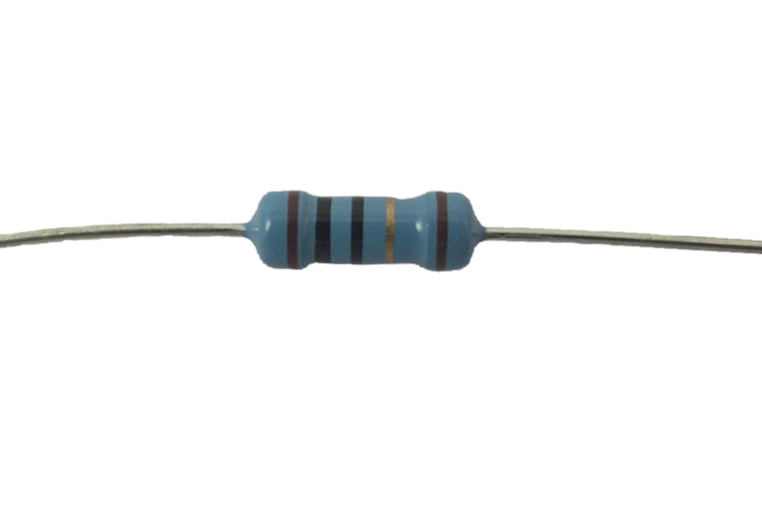
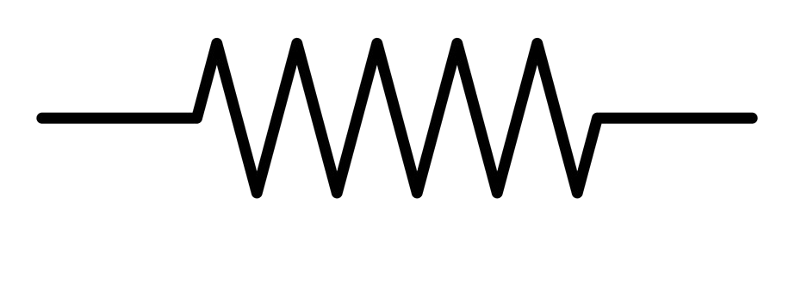
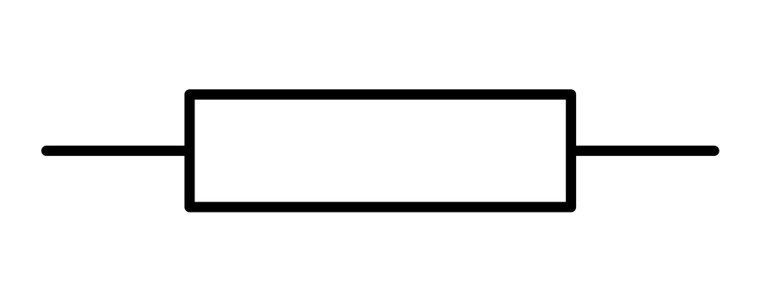
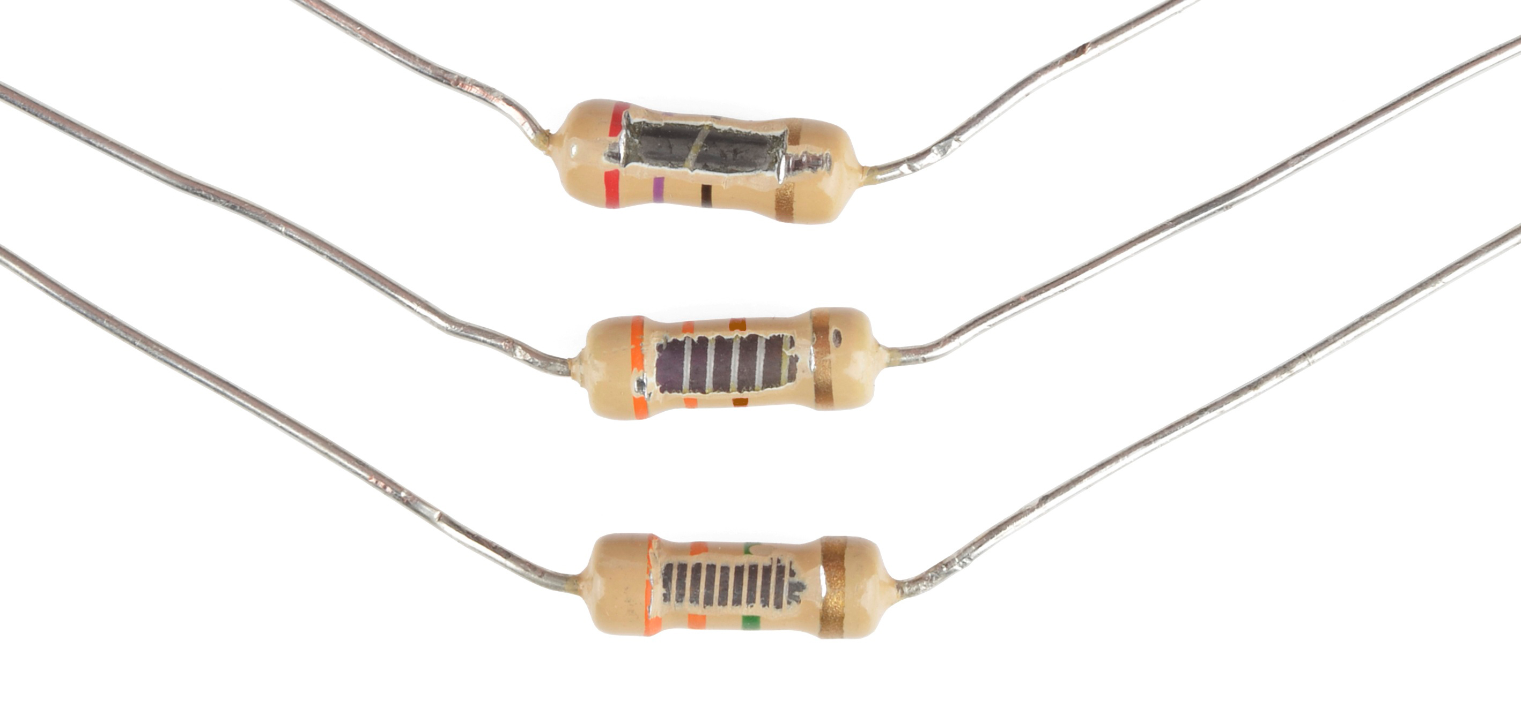
Component Spotlight: The Resistor
Ohms(Ω)
Notes:
3300 ohm
10 ohm

Slide 25
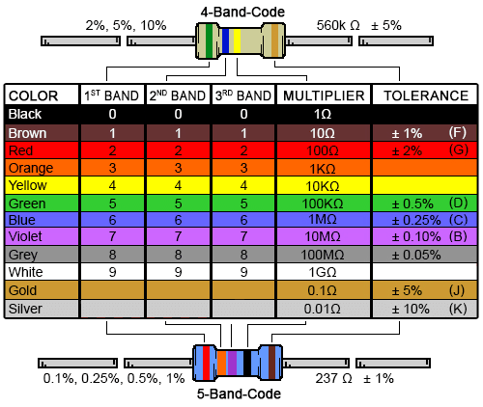
Decoding Resistor Values

Slide 26
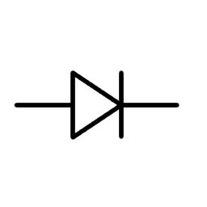
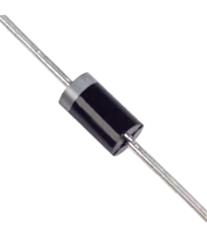

Component Spotlight: The LED
Diode
Notes:
Has enough energy to get over but not back

Slide 27
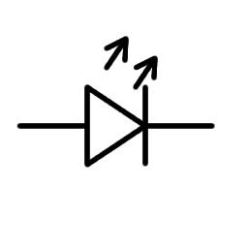
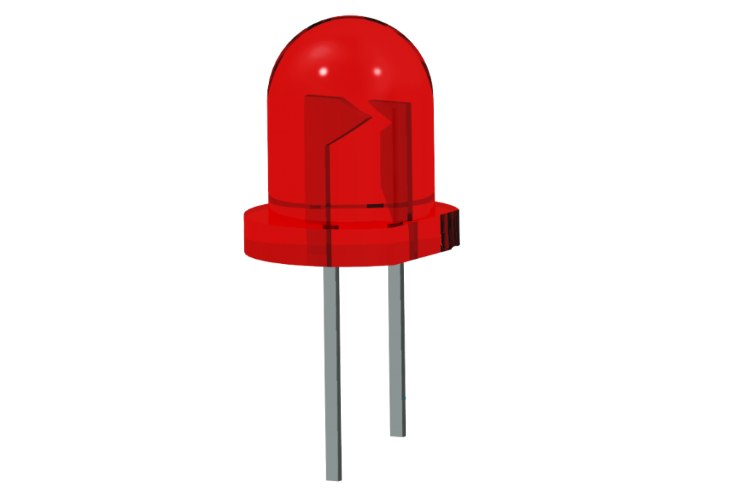
Component Spotlight: The LED
Light Emitting Diode

Slide 28

Component Spotlight: The LED

Slide 29


LED Mnemonic
Cathode, like Kathy, is short and negative

Slide 30

Using the Breadboard to built a simple circuit
Use the breadboard to wire up
a single LED
a 220 Ω Resistor
(Red-Red-Black-Black-Gold)
or
(Red-Red-Brown-Gold)

Slide 31

Using the Breadboard to built a simple circuit

Slide 32



Go ahead and plug your board in!

Slide 33

Adding Control

Slide 34

Concepts: INPUT vs. OUTPUT
Referenced from the perspective of the microcontroller
Input is a signal / information going into the board.
Output is any signal exiting the board.
Almost all systems that use physical computing will have an output
What are some examples of inputs and outputs?

Slide 35


Concepts: INPUT vs. OUTPUT
Referenced from the perspective of the microcontroller
Input is a signal / information going into the board.
Output is any signal exiting the board.
Examples: Buttons, Switches, Microphones, Light Sensors, Touch Sensors, Flex Sensors, Humidity Sensors, Temperature Sensors…
Examples: LEDs, RGB LEDs, monitors, relays, DC motors, servo motors, buzzers, speakers

Slide 36

Concepts: Analog vs. Digital
Microcontrollers are digital devices – ON or OFF. Also called discrete.
Analog signals are anything that can be a full range of values. What are some examples?
5 V
5 V
0 V
0 V

Slide 37






digitalWrite()
analogWrite()
if() statements / Boolean logic
BIG 6 CONCEPTS
digitalRead()
analogRead()
Serial communication

Slide 38
digitalWrite()
Project #1 – Blink
“Hello World” of Physical Computing
Psuedo-code – how should this work?
Turn LED ON
Turn LED OFF
Rinse & Repeat
Notes:
In 1969 Ken Thompson and Dennis Ritchie developed a programming language called B, since it was a stripped-down version of of another language- BCPL, “Basic Combined Programming Language”
In 1972 Brian Kernigham’s book A Tutorial Introduction to the Language B included printing “hi!” as one of the first examples
The next example, used to illustrate external variables, was the slightly more complicated “hello, world!”
This phrase got taken up at Bell Labs, where the language was developed
When B evolved into C, Kerningham included “hello world” in his hugely popular book The C Programming Language (1978)

Slide 39
digitalWrite()
Project #1 – Blink
“Hello World” of Physical Computing
Psuedo-code – how should this work?
Turn LED ON
Wait
Turn LED OFF
Wait
Rinse & Repeat
Notes:
In 1969 Ken Thompson and Dennis Ritchie developed a programming language called B, since it was a stripped-down version of of another language- BCPL, “Basic Combined Programming Language”
In 1972 Brian Kernigham’s book A Tutorial Introduction to the Language B included printing “hi!” as one of the first examples
The next example, used to illustrate external variables, was the slightly more complicated “hello, world!”
This phrase got taken up at Bell Labs, where the language was developed
When B evolved into C, Kerningham included “hello world” in his hugely popular book The C Programming Language (1978)

Slide 40
Project #1 - Blink Inputs and Outputs
Turn LED ON
Wait
Turn LED OFF
Wait
Rinse & Repeat
Inputs | Outputs
None | LED/resistor

Slide 41

Project #1 - Blink Schematic
Move the blue wire from the power bus to pin 12 (or any other Digital I/O pin) on the microcontroller board.

Slide 42

Project #1 – Blink Wiring Diagram

Slide 43


Open up Arduino IDE
IDE → Integrated Development Environment
Lets you write, compile (and upload) code all in the same place
Versions 1 and 2 are aesthetically different, functionally the same (for our purposes)

Slide 44

Exploring the Arduino IDE
CODING WINDOW
Port / Board Selection
Verify
Button
Upload
Button
SERIAL / OUTPUT WINDOW

Slide 45

Settings: Tools → Serial Port
Your computer communicates to the microcontroller via a serial port through a USB-Serial adapter.
Check to make sure that the drivers are properly installed.
Notes:
All connections to computers- mice, printers etc use a serial port. Gotta pick the right one.

Slide 46

Settings: Tools → Board
Next, double-check that the proper board is selected under the
Tools → Board menu.
Notes:
All connections to computers- mice, printers etc use a serial port. Gotta pick the right one.

Slide 47

Coding
This is like trying to learn ‘sports’ in a few hours, or ‘cooking’ or anything else that is a field of study unto itself
We’re going to go over some very broad concepts, in the form of commands and function, giving you just enough to be dangerous
You can copy/paste the examples, or type them in yourself, then we’ll review what each is doing line by line

Slide 48

Commands
Commands are what you want the microcontroller to do. They’re a code to translate between English and computer-speak
Only one command can go on a line
Because it’s a code, the syntax or how you type the commands, is very important
If you don’t get it just right, the output at the bottom of the IDE will try to tell you what’s wrong

Slide 49
Project #1 – Blink Three Command to Start
pinMode(pin, INPUT/OUTPUT);
// NOTE: -> commands are CASE-sensitive
Notes:
Three commands to rule the world… or at least do 80% of cool Arduino projects.

Slide 50
Project #1 – Blink Three Command to Start
pinMode(pin, INPUT/OUTPUT);
ex: pinMode(12, OUTPUT);
// NOTE: -> commands are CASE-sensitive
Notes:
Three commands to rule the world… or at least do 80% of cool Arduino projects.

Slide 51
Project #1 – Blink Three Command to Start
pinMode(pin, INPUT/OUTPUT);
ex: pinMode(12, OUTPUT);
digitalWrite(pin, HIGH/LOW);
// NOTE: -> commands are CASE-sensitive
Notes:
Three commands to rule the world… or at least do 80% of cool Arduino projects.

Slide 52
Project #1 – Blink Three Command to Start
pinMode(pin, INPUT/OUTPUT);
ex: pinMode(12, OUTPUT);
digitalWrite(pin, HIGH/LOW);
ex: digitalWrite(12, HIGH);
// NOTE: -> commands are CASE-sensitive
Notes:
Three commands to rule the world… or at least do 80% of cool Arduino projects.

Slide 53
Project #1 – Blink Three Command to Start
pinMode(pin, INPUT/OUTPUT);
ex: pinMode(12, OUTPUT);
digitalWrite(pin, HIGH/LOW);
ex: digitalWrite(12, HIGH);
delay(time_ms);
// NOTE: -> commands are CASE-sensitive
Notes:
Three commands to rule the world… or at least do 80% of cool Arduino projects.

Slide 54
Project #1 – Blink Three Command to Start
pinMode(pin, INPUT/OUTPUT);
ex: pinMode(12, OUTPUT);
digitalWrite(pin, HIGH/LOW);
ex: digitalWrite(12, HIGH);
delay(time_ms);
ex: delay(2500);
// NOTE: -> commands are CASE-sensitive
Notes:
Three commands to rule the world… or at least do 80% of cool Arduino projects.

Slide 55
Functions
Functions are groups of commands
They need a unique name
They can take numbers as inputs (arguments) and spit out a number as an output (return) but don’t have to
They begin and end with curly brackets → { }
We wont be dealing with them in too much more detail, save every Arduino program requires two functions, the setup() function and the loop() function

Slide 56

Notes:
Review the two main parts of the sketch – void setup() and void loop()
Provide rationale for good commenting.
Emphasize the need for good / clean coding practices like indenting.

Slide 57
Comments, Comments, Comments
Comments are ignored by the microcontroller. They’re just for you – the programmer and your friends…or anyone else human that might read your code.
// this is for single line comments
/* this is for multi-line comments
Like this…
And this….
*/

Slide 58

comments
Notes:
Review the two main parts of the sketch – void setup() and void loop()
Provide rationale for good commenting.
Emphasize the need for good / clean coding practices like indenting.

Slide 59

Project #1 - Blink Code Review

Slide 60
Project #1 – Blink Puzzles
Challenge 1a – blink with a 200 ms second interval.
Challenge 1b – find the fastest blink that the human eye can still detect…
1 ms delay? 2 ms delay? 3 ms delay???
Challenge 1c – blink to mimic a heartbeat
Challenge 1d – change the output pin

Slide 61
analogWrite()
Project #2 – Fade
Not so fast, Jack
Psuedo-code – how should this work?
LED Gets Brighter
Achieves Maximum Brightness
LED Dims
Goes completely off
Rinse & Repeat
Goes c

Slide 62
Project #2 – Fade Inputs and Outputs
LED Gets Brighter
Achieves Maximum Brightness
LED Dims
Goes completely off
Rinse & Repeat
Goes c
Inputs | Outputs
None | LED/resistor

Slide 63

Project #2 – Fade Schematic
Move the blue wire to pin 9 (or 3, 5, 6, 10 or 11) on the microcontroller board.

Slide 64

Project #2 – Fade Wiring Diagram

Slide 65
Fading in and Fading Out (Analog or Digital?)
A few pins on the Arduino allow for us to modify the output to “mimic” an analog signal.
This is done by a technique called:
Pulse Width Modulation (PWM)

Slide 66





Concepts: Analog vs. Digital
To create an analog signal, the microcontroller uses a technique called PWM. By varying the duty cycle, we can fool the eye into seeing an average brightness.
Pulse Width Modulation (PWM)

Slide 67


Programming Concepts: Variable

Slide 68


Programming Concepts: Variable Types
Variable Types:
8 bits
16 bits
32 bits
byte/char
2⁸ = 256 values
(0 - 255)
int/ unsigned int
2¹⁶ = 65,536 values
(-32728 – 32727)
(0 – 65535)
long/unsigned long
2³² = 4,294,967,296
(-2147483648 – 2147483647)
(0 – 4294967295)

Slide 69

How Big Is 2³²?
The function millis() returns the number of milliseconds since the program started
The type of data millis() returns is an unsigned long int
4,294,967,296 milliseconds is 49.71 days

Slide 70
Variables: Which Cup Should You Choose?
Variable Types:
8 bits
16 bits
32 bits
byte/char
2⁸ = 256 values
(0 - 255)
int/ unsigned int
2¹⁶ = 65,536 values
(-32728 – 32727)
(0 – 65535)
long/unsigned long
2³² = 4,294,967,296
(-2147483648 – 2147483647)
(0 – 4294967295)

Slide 71
Variables: Which Cup Should You Choose?
Variable Types:
8 bits
16 bits
32 bits
byte/char
2⁸ = 256 values
(0 - 255)
int/ unsigned int
2¹⁶ = 65,536 values
(-32728 – 32727)
(0 – 65535)
long/unsigned long
2³² = 4,294,967,296
(-2147483648 – 2147483647)
(0 – 4294967295)

Slide 72


Programming Concepts: Variable Scope
Global
---
Local

Slide 73

Project #2 – Fade New Command!
analogWrite(pin, val);
pin – refers to the OUTPUT pin (limited to pins 3, 5, 6, 9, 10, 11.) – denoted by a ~ symbol
val – byte/char value (0 – 255).
0 => 0V | 255 => 5V

Slide 74

Fade - Code Review

Slide 75
Project #2 - Fade Puzzles
Challenge 2a – Change the rate of the fading in and out. There are at least two different ways to do this – can you figure them out?
Challenge 2b – Use 2 (or more) LEDs – so that one fades in as the other one fades out.

Slide 76



Project #2.1- Color Mixing RGB LED
R
G
B
Common Cathode LED
This means the negative side of the LED is all tied to Ground.

Slide 77


Project #2.1 – Color Mixing Schematic
Note: The longest leg of the RGB LED is the Common Cathode. This goes to GND.
Use pins 5, 6, & 9

Slide 78

Project #2.1 – Color Mixing Wiring Diagram
Notes:
Pause for code transfer

Slide 79

Project #2.1 - Color Mixing Code Review

Slide 80


How many unique colors can you create?
Click the “Color Picker” link at microcontrollers.smartypantsconsulting.ltd
Pick out a few colors that you want to try re-creating for a lamp or lighting display...
Play around with this and the analogWrite() command.

Slide 81
Project #2.1 - Color Mixing Code Review

Slide 82



Project: Mood Lamp / Light Sculpture
Notes:
Here are a few examples of project ideas that you can extend this to in the class.

Slide 83


Slide 84




Special Thanks:
www.sparkfun.com
6175 Longbow Drive, Suite 200
Boulder, Colorado 80301

